Slide 1

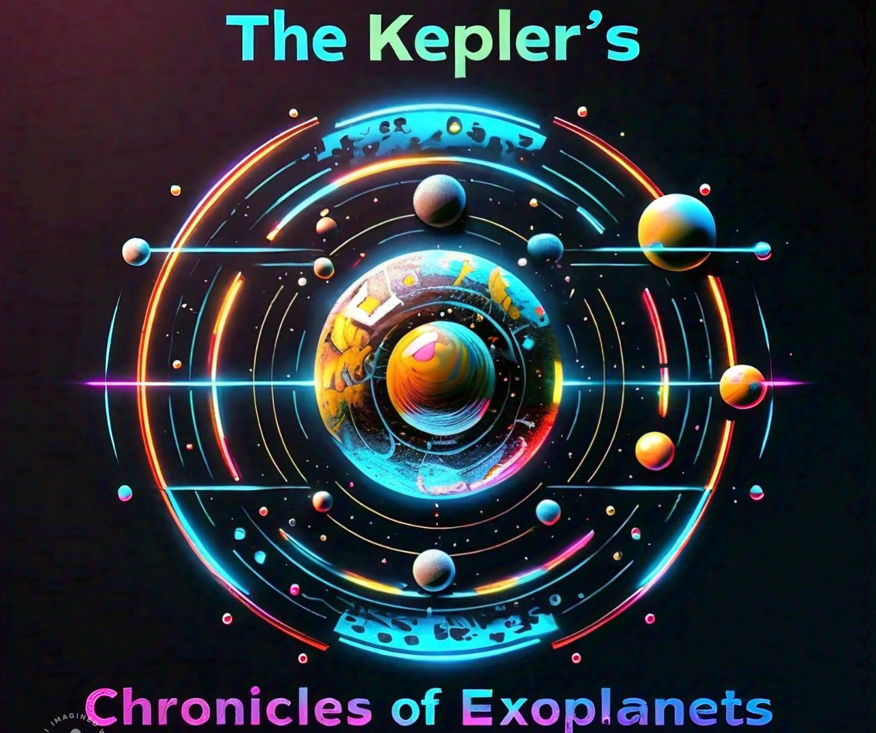
NASA Space apps challenge 2024
Team : The Kepler’s
Challenge : The Chronicles of Exoplanets
Notes:
NOTE:
To change the image on this slide, select the picture and delete it. Then click the Pictures icon in the placeholder to insert your own image.

Slide 2
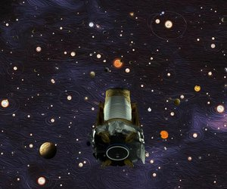

TEAM AND CHALLENGE
Our challenge is to develop engaging and accessible learning materials that leverage creativity to enlighten students about the wonders of exoplanets.
We are team of designers, developers, and astro researchers focused on creating an innovative web platform to assist users in selecting the most suitable exoplanet for research and exploration purpose
Our goal is to create a platform that will provide unique experience to user using an innovative platform. It will tend user to work like a scientist in choosing an Exoplanet when and where it is required
CHRONICLES OF EXOPLANET EXPLORATION

Slide 3
OUR APPROACH
First of all, we started our research on Exoplanets. What are they, how are they classified, and how it is found in outer solar systems.
Others started to working on the development of the model.
Our focus was to develop an interactive 3D visualization of exoplanets using Three.js, which is a JS Library for rendering animated 3D graphics.
We worked on HTML file that hosted the 3D visualization and CSS file to provide design to our pages.

Slide 4
OUR APPROACH
Functions like startThreeJS() initialize the scene with planets, and goBack() allows users to reset the camera view.script.js
We also included the audio playback as soon as the page loads, enhancing the user experience with auditory feedback.
styles.css provides the basic styling rules for the layout ensuring elements to align and display properly.
To represent the 3D planets, textures and background were added providing a realistic sappearance to render the planets.

Slide 5
WHAT USER CAN DO?
Users can interact with the visualization to learn more about each planet by clicking on them, which brings up detailed information and shifts the camera focus.
The project serves as an educational tool, providing detailed visual and textual information about different exoplanets
The use of audio and high-quality textures helps in keeping the audience engaged and makes the learning process enjoyable
Demonstrates the capabilities of web technologies like HTML, CSS, JavaScript, and Three.js in creating educational and interactive 3D applications.

Slide 6
RESOURCES USED
NASA Exoplanets
NASA Exoplanet Archive
"Eyes on Exoplanets"
Pieces for developer
Perplexity AI

Slide 7
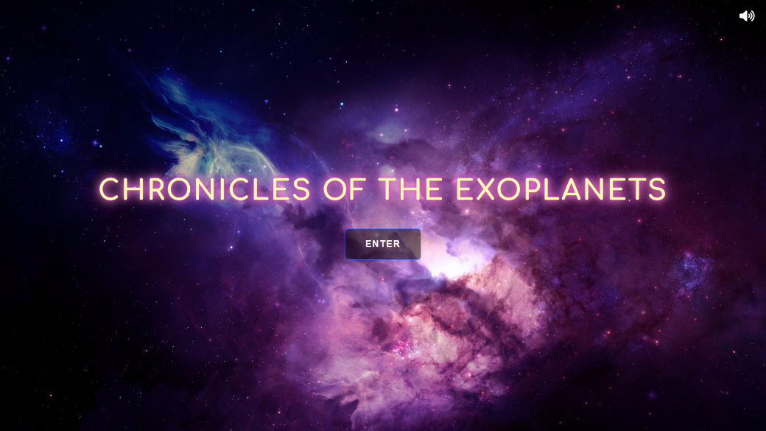
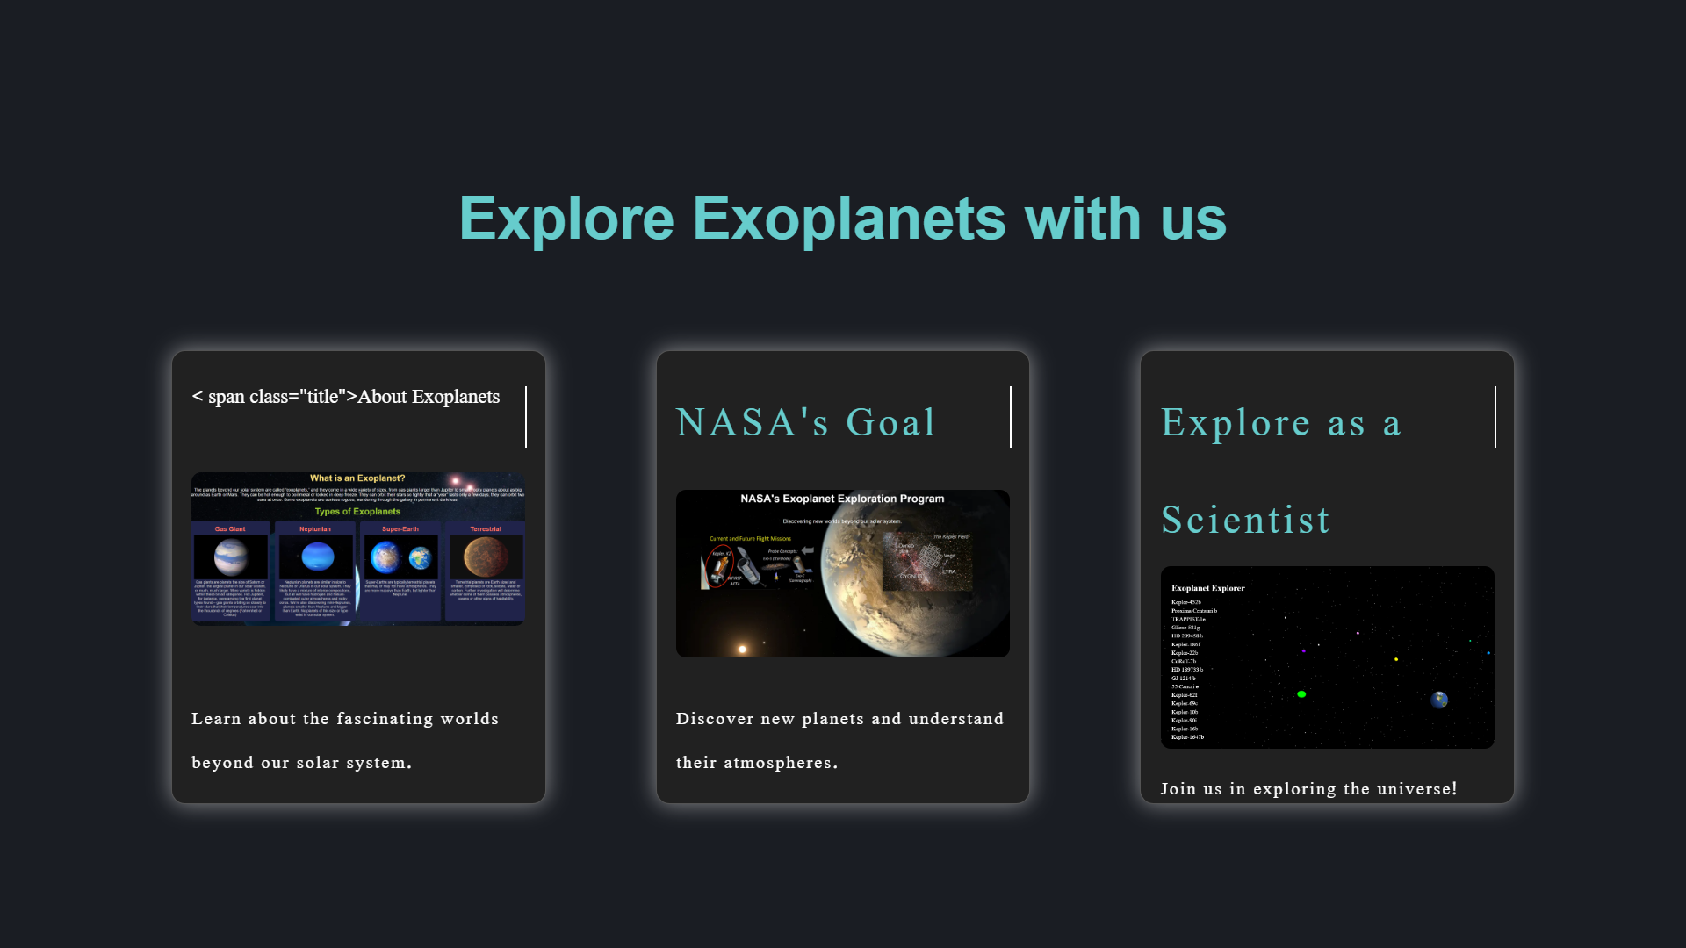
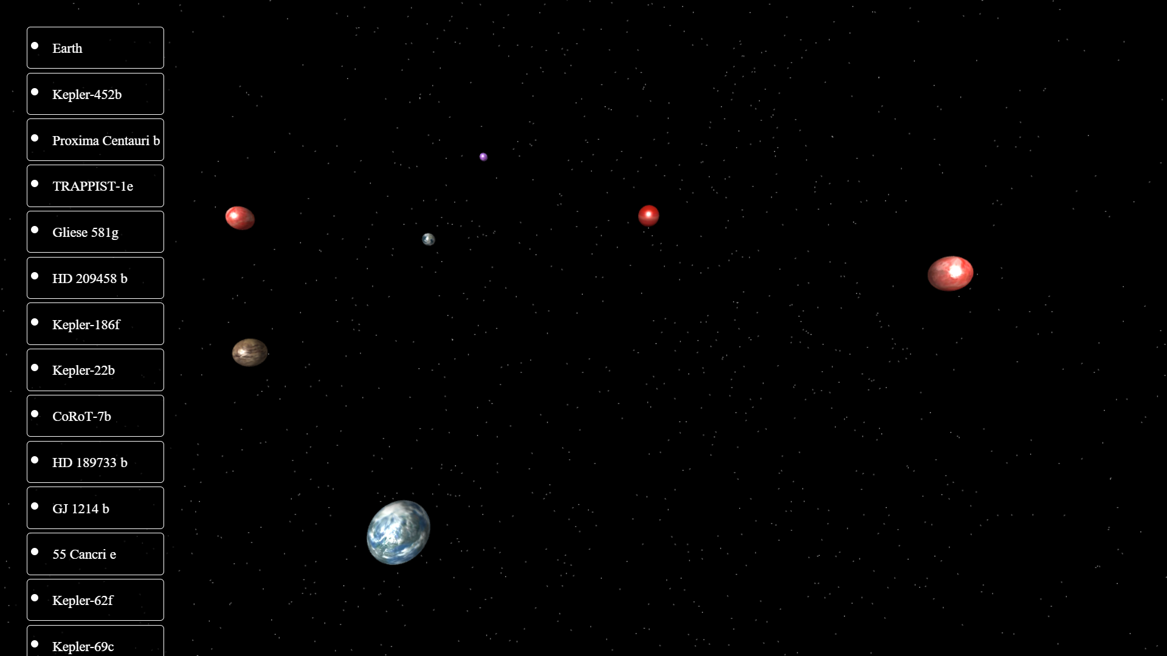
GLIMPSES OF PROJECT

